Slide 1
CT2003 Team 5
LWIN MOE OO
MUHAMMAD FIRDAUS BIN KAMARUDIN
MURPHY WONG KAH LEONG
PANG WEI JIE
PAZHANISAMY HARISH PRABHU

Slide 2
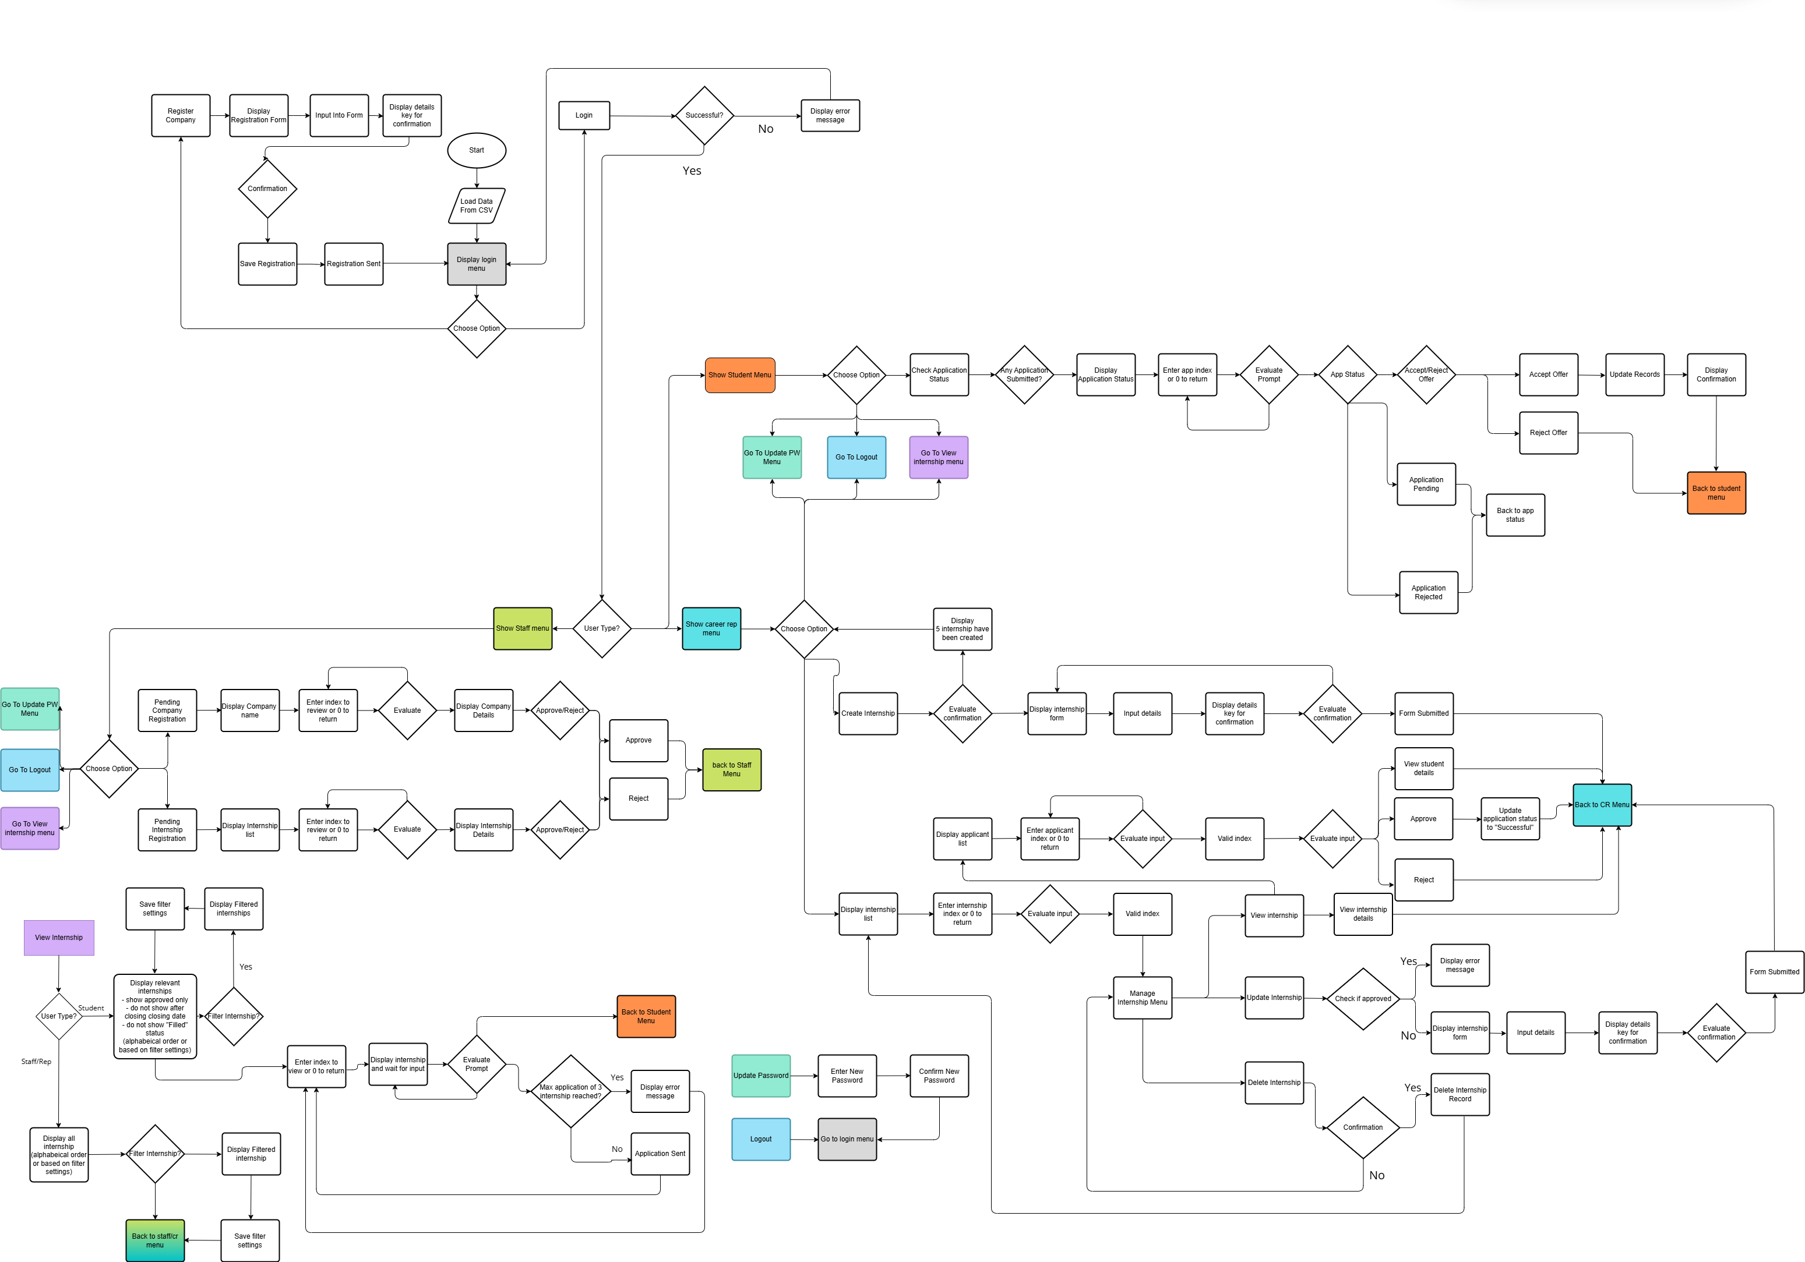
Activity Diagram
Text Goes here
Main activity flow of the program
Covers all user types and respective tasks
Handles alternative paths and error checking

Slide 3
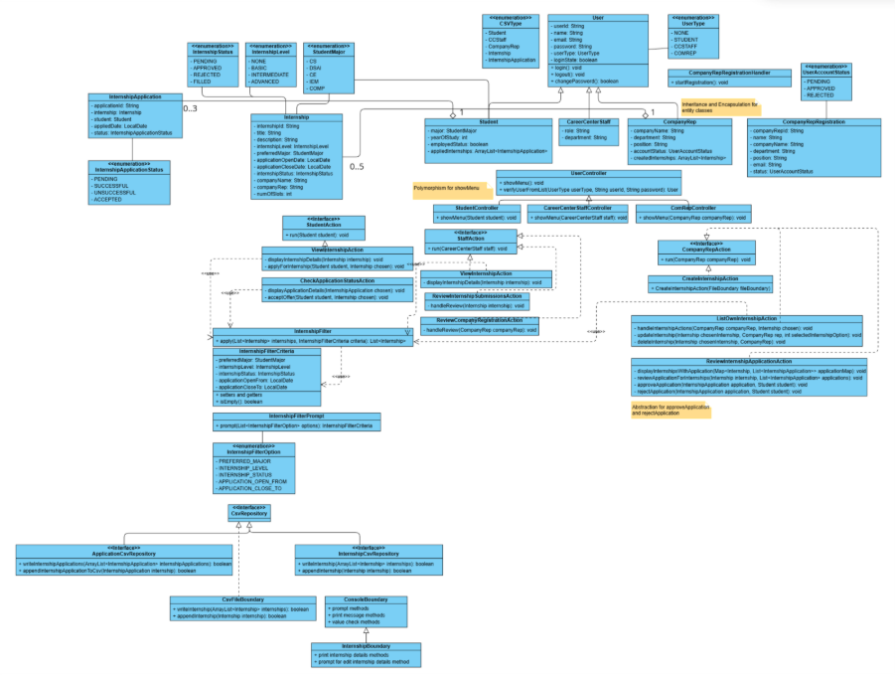
Class Diagram
Implemented superclass and subclasses
Defines relationship between each classes
Implemented Enum classes for easy interpretation for different status
Using interfaces and implement concrete classes

Slide 4
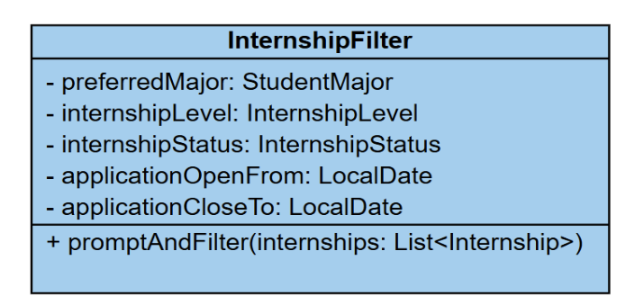
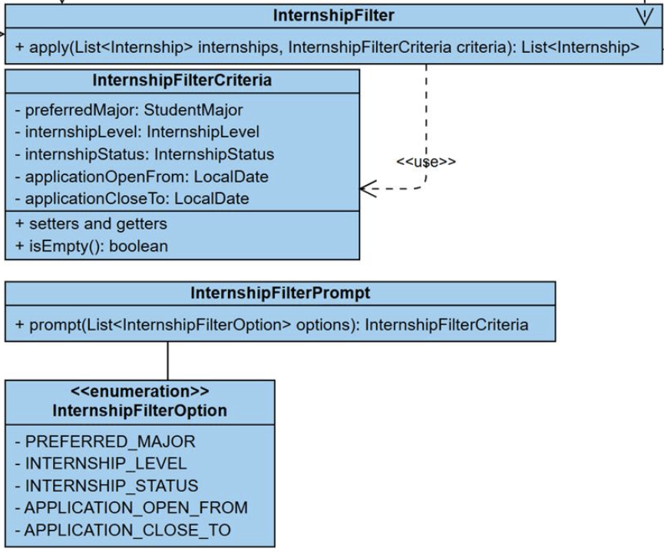
Single Responsibility Principle (SRP)
Each class will only focus on one main task
Only have one reasons for modification
E.g. InternshipFilter
Notes:
Firdaus

Slide 5
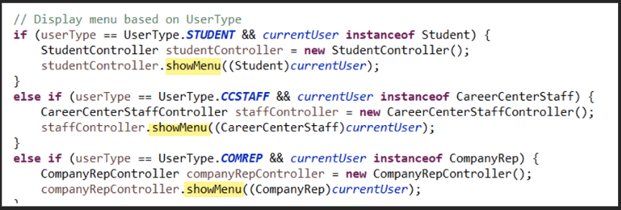
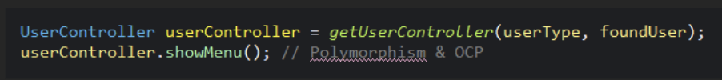
Opened/Closed Principle (OCP)
Closed for Modification:
  The UserController abstract class defines a stable contract that doesn't change.
Open for Extension:
  Each user type (StudentController, StaffController) extends the base class with its own specific behavior.
OCP in Action:
  A new user type (like AdminController) is added as a new class, not an edit to existing code.
Notes:
Wei Jie

Slide 6
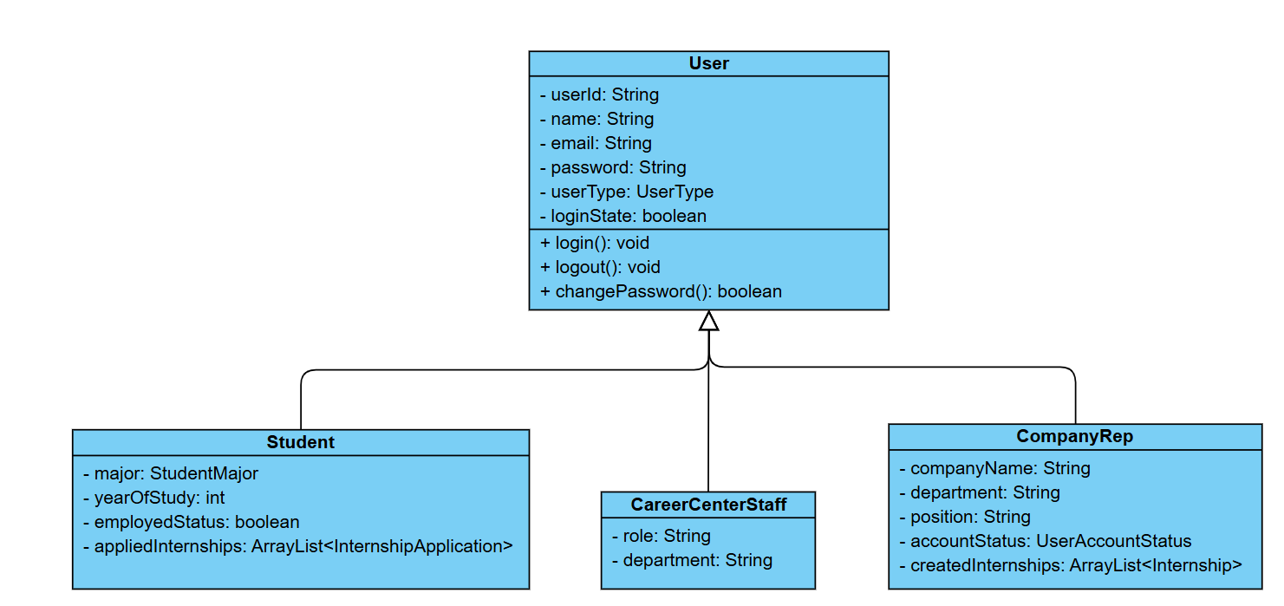
Liskov Substitution Principle (LSP)
True Substitutability:
  Any code designed to work with a superclass object (e.g., a User object) must also work perfectly if it's given a subclass object (e.g., a Student or CompanyRep) instead.
Behavioral Consistency: The subclass must honor the "contract" and expected behavior of its superclass.
  It can add new methods and properties (like Student adding major).
  It cannot change the fundamental behavior of the original methods (like login() or changePassword()).
No Surprises: A subclass shouldn't cause new, unexpected side effects or errors. For example, if User.changePassword() just changes the password, the Student.changePassword() method shouldn't also send an email to a professor, as that would be a "surprising" behavior the original code didn't expect.
Notes:
Harish

Slide 7
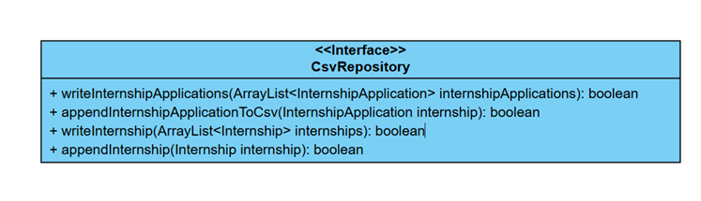
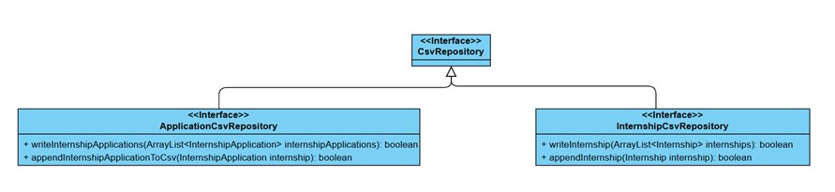
Interface Segregation Principle (ISP)
Before: Classes implementing CSVRepository will have to handle all 4 methods when using it. This forces implementing classes to include methods that we may not need, hence violating ISP.
After: The proposed design changes refactor it into 2 separate interfaces: 1 to handle internship and the other to handle internship applications. This enforces each class only have depends on the method it is using, which aligns with ISP.
E.g. CSVRepository
Notes:
: D

Slide 8
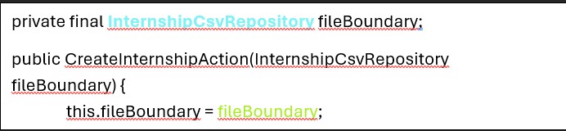
Dependency Inversion Principle (DIP)
High-level depends on Abstraction: CreateInternshipAction (high-level) depends on the InternshipCsvRepository interface, not a concrete class.
Low-level depends on Abstraction: CsvFileBoundary (low-level) implements the CsvRepository interface, fulfilling the abstraction.
Enables Inversion of Control: The dependency is "injected," allowing CsvFileBoundary to be swapped out (e.g., for testing) without changing CreateInternshipAction.
Notes:
Moe

Slide 9
Demo Time

Slide 10
Reflection
Planning starts from designing class diagrams
Distributed implementation tasks among members
Held regular meetings for discussion
Learnt to apply SOLID principles for future maintainability
Create detailed documentation for reference

Slide 11
Q&A
Questions?

